Slide 1

Postpartum Adaption and Nursing Assessment
Presented by Connie S. Kelling, WHNP, MSN, RN

Slide 2
Objectives:
Identify the anatomical structures involved with the postpartum client.
Learn the physiological changes that occur in the postpartum client, including lab findings and vital signs.
Learn the BUBBLE-HER assessment.
Identify care considerations of the cesarean section/surgical patient.
Become familiar with postpartum teaching topics for both mom and baby.
Discuss common postpartum medications and their nursing considerations.
Identify possible Nursing Diagnosis of the postpartum patient.

Slide 3
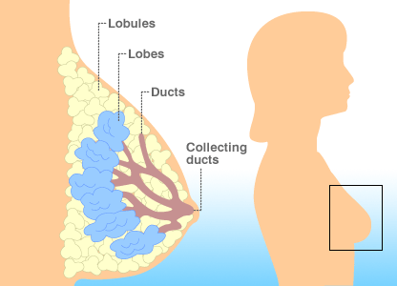
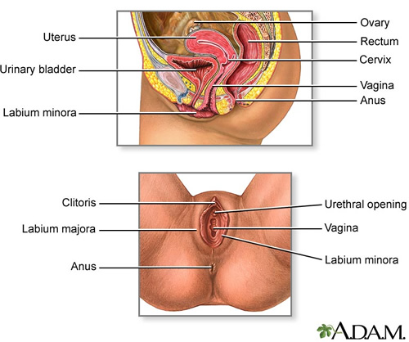
What structures are involved?
Breast
Uterus
Abdomen
Bowel
Bladder
Vagina
Cervix
Perineum
Extremities

Slide 4

Breast Changes
Ready to make milk (lactation)
Larger than prepregnancy
Nipples may be more erect

Slide 5
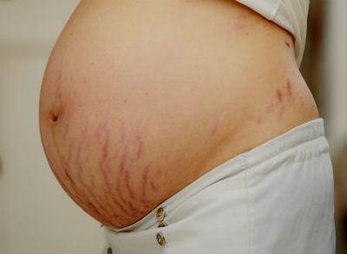
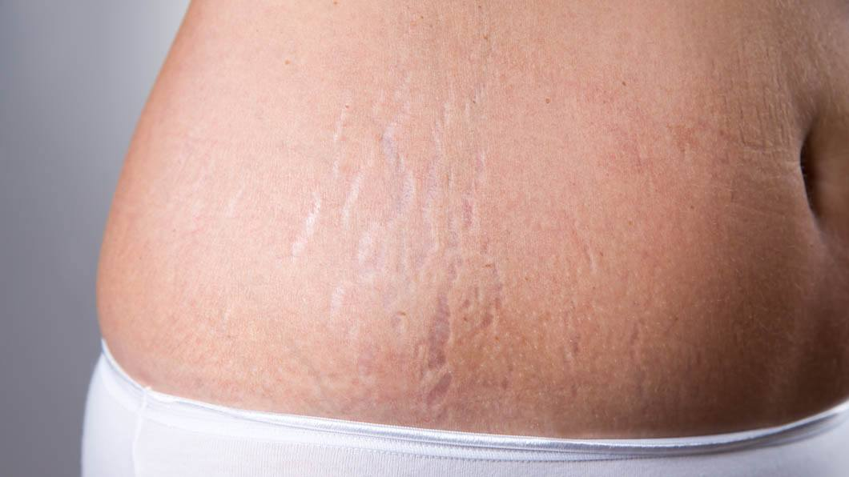
Abdominal Changes
Loose and flabby but will respond to exercise
Diastasis Recti abdominis
Striae (stretch marks) will take on different colors based on the mothers skin color

Slide 6
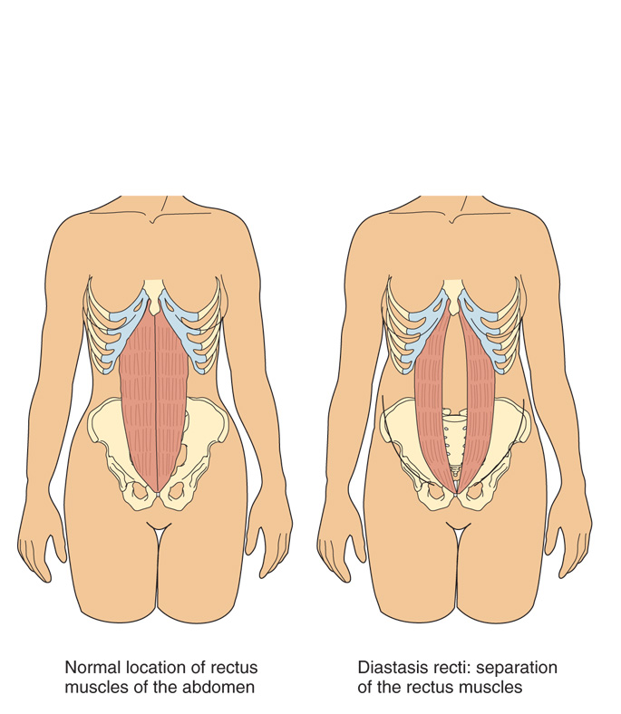
Figure 34–3 Diastasis recti abdominis, a separation of the musculature, commonly occurs after pregnancy.

Slide 7
Uterine changes
Decreases in weight
Decidua is sloughed off
Basal layer differentiates into 2 layers:
Outer layer sloughs off
Inner layer begins the foundation for a new endometrium
Placental site heals by exfoliation

Slide 8
Uterine changes (cont)
Uterine debris in the uterus is discharged through LOCHIA
Lochia Rubra is Red (first 2-3 days)
Lochia Serosa is Pink (day 3-10)
Lochia Alba is White (continues until the cervix is closed)

Slide 9
Vaginal & Cervical Changes
Cervix is spongy, flabby, and may appeared bruised
External os may have lacerations and is irregular and closes slowly
Shape of the external os changes to a lateral slit
Vagina may be edematous, bruised with small superficial lacerations
Size decreases and rugae reappear within 3-4 weeks
Returns to prepregnant state by 6 weeks

Slide 10
Perineal Changes & Return of Menstruation
Perineum may be edematous, with bruising
Lacerations or an episiotomy may be present
Menstruation generally returns between 6 and 10 weeks (nonbreastfeeding)

Slide 11
Perineum
Episiotomy versus tearing
Midline versus mediolateral
Degrees:
First degree
Second degree
Third degree
Fourth degree
https://www.mayoclinic.org/healthy-lifestyle/labor-and-delivery/multimedia/vaginal-tears/sls-20077129?s=1

Slide 12
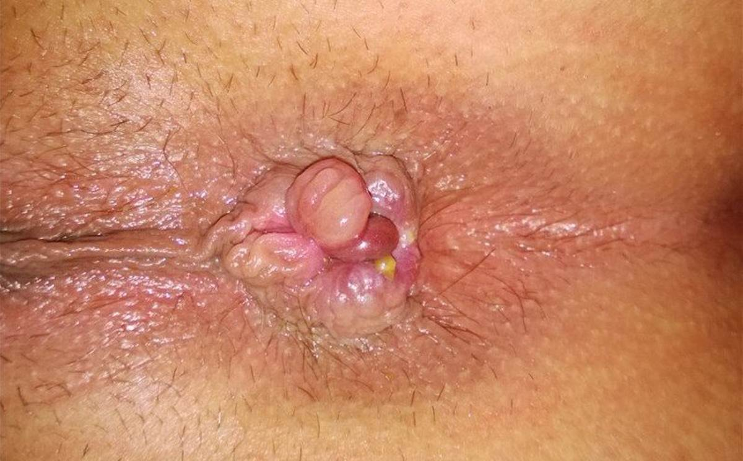
Bowel Changes
Bowels will be sluggish
Episiotomy, lacerations, or hemorrhoids may delay elimination

Slide 13
Bladder Changes
Increased bladder capacity
Swelling and bruising of tissues around the urethra
Decrease in sensitivity to fluid pressure
Decrease in sensation of bladder filling
Urinary output is greater due to puerperal diuresis
Increased chance of infection due to dilated ureters and renal pelves

Slide 14
Lab Values change
Blood loss averages 200-500 mL (vaginal), 700-1000 mL (cesarean)
Plasma levels reach the prepregnant state by 4-6 weeks postpartum
Platelet levels will return to normal by the 6th week
Diuresis
Cardiac output returns to normal by 6-12 weeks

Slide 15
Vital signs change
Temperature may be increased for 24 hours after the milk comes in
BP rises early and then returns to normal
Bradycardia occurs during first 6-10 days

Slide 16

POSTPARTUM ASSESSMENT:
RULES to the Task:
1. Selecting the time that will provide the most accurate data
2. Providing an explanation of the purpose of the assessment
3. Ensuring that the woman is relaxed before starting
4. Record and report the results clearly
5. Body fluid precautions

Slide 17

ACRONYM FOR PP ASSESSMENT
B – Breasts
U – Uterus
B – Bowel
B – Bladder
L – Lochia
E – Episiotomy/Lacerations
H – Homan’s/ Hemorrhoids
E – Emotions
R – Rubella and/or RhoGam

Slide 18
“E” motion
https://www.injoyonline.com/learn/course/understanding-birth-stories-videos/birth-stories/perinatal-mood-anxiety-disorders

Slide 19
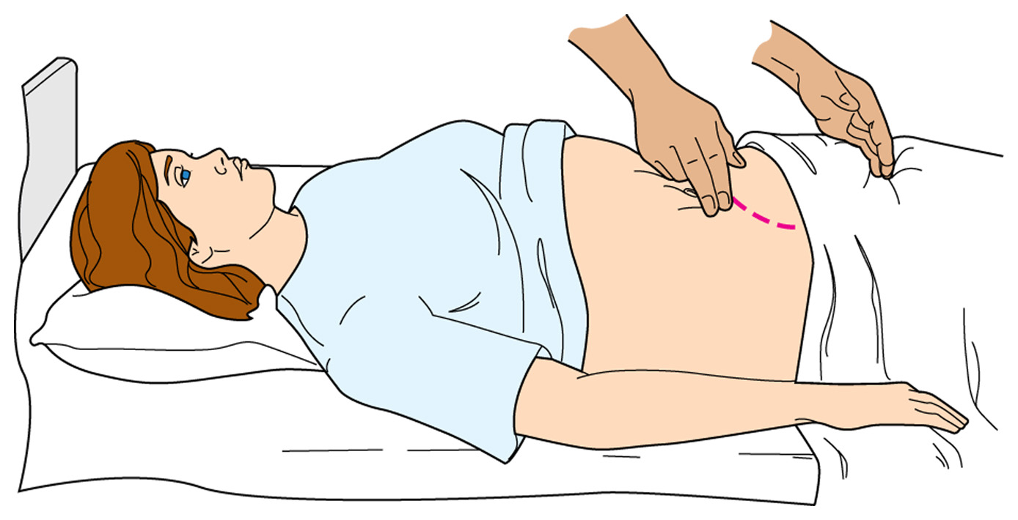
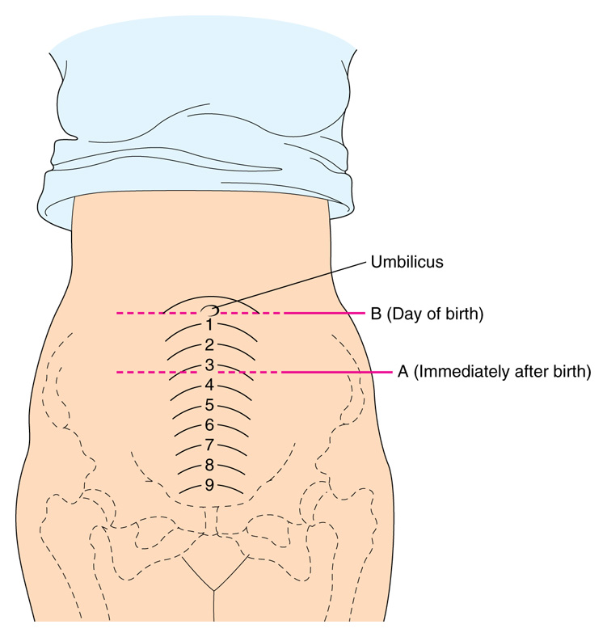

Slide 20
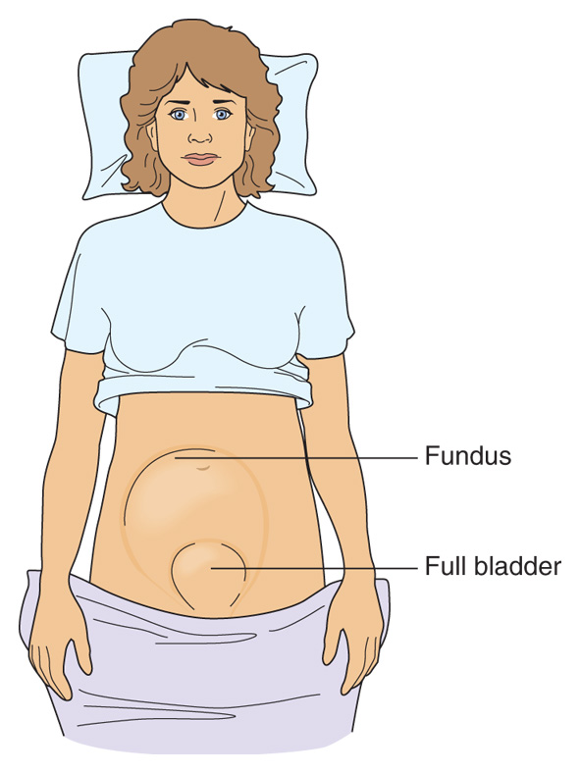
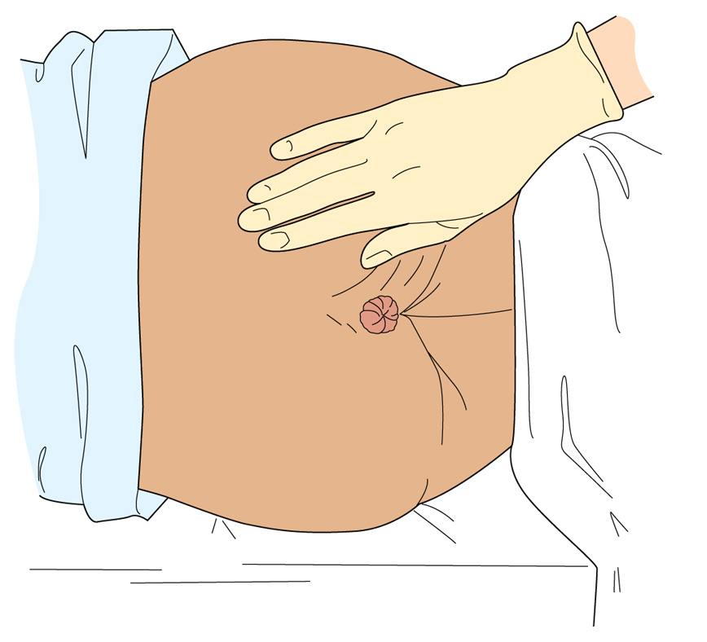

Slide 21

Care of the C/S mom
Pain medication
Bowel function
Urinary function
Respiratory function
Incision care

Slide 22
Postpartum Teaching for MOM
Topics will include:
Breast care
Involution
Hygiene/perineal care
Bowel norms (C/S mom)
Incision Care (C/S & perineal repairs)
Rest & Activity
Warning signs
Emotional Changes
Pain medication

Slide 23




Teaching mom about baby care
Cord care
Infant safety & Security
Burping, holding comforting
Diapering and skin care, baths (males uncirc)
Warning signs
Immunizations (Hep B)
Skin tone
Feeding schedule
Normal temp, resp, temperament
Normal urine and stool

Slide 24

Common Medications Postpartum
Constipation:
Colace (docusate)
Sennakot,
MOM Dulcolax suppository
For pain:
Tylenol
Tylenol #3
Oxycodone or
Percocet 5/325mg
Ibuprofen (Motrin) 400mg- 800mg
For Breast Care - Lanolin
Contraception
Depo Provera OCP IUD
Vaccinations
Rubella TDaP
Pneumovax
Rhogam Influenza
Antibiotics
Replenish stores
PNV Ferrous sulfate
Perineal comfort
Tucks (Witch Hazel pads)
Lidocaine spray

Slide 25

Possible Nursing Diagnosis
Pain Related To….
Knowledge Deficit AEB….
Fatigue AEB…
Language Barrier AEB….
Substance Abuse EAB…
Ineffective Breastfeeding AEB….
Risk for Constipation Related To…
Impaired Mobility Related To…

